Slide 1

My Parents Kicked Me Out!
Where do I go now..?

Slide 2
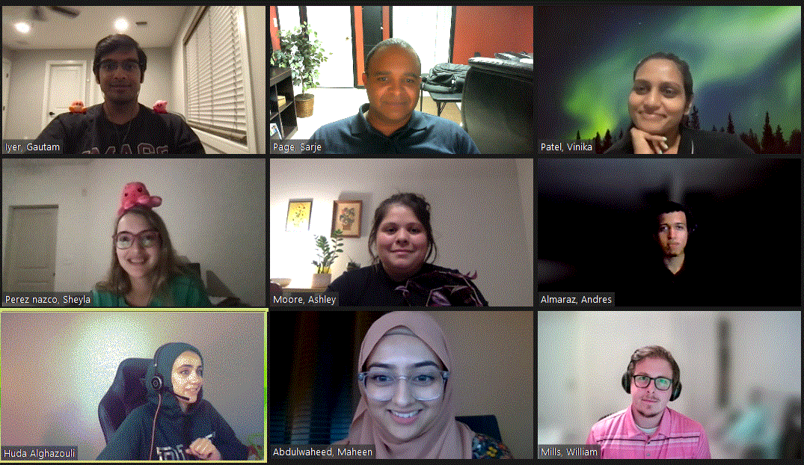
Who Are We?
Maheen Abdulwaheed
Huda Alghazouli
Andres Almaraz
Gautam Iyer
William M Mills
Ashley Moore
Sarje Page
Vinika Patel
Sheyla Perez Nazco
Notes:
Gautam
Whos on the team?
Great place for a group screen shot or Gif from Sarje!
! Everyone give your name a Text color, or format !??
We can always provide the list of names if needed.
Maheen Abdulwaheed
Huda Alghazouli
Andres Almaraz
Gautam Iyer
William M Mills
Ashley Moore
Sarje Page
Vinika Patel
Sheyla Perez Nazco

Slide 3
My Parents Kicked Me Out!
Now where do I go?
In our latest "Ask the Data Experts" blog, we received the following question from Paul, who just got kicked out of his parent's house in Decatur, Georgia:
"Having spent many years with my parents, they finally decided to kick me out! 😟 But where do I go now? Do I stay in Georgia or move to another State? Should I look for a studio or a 1 bedroom apartment, or should I get roommates instead? Would you all be able to use data to help me with some recommendations?" - Paul (29 years old)
When digging further into Paul's preferences, he mentioned the following:
Affordability is important.
Open to living with or without roommates.
Most of his friends and family live in Georgia, but he's open to moving to another state.
Wants to feel safe
Paul is a homebody - but he wants to make sure there's things to do whenever he feels like getting out of the house!
Notes:
Gautam

Slide 4
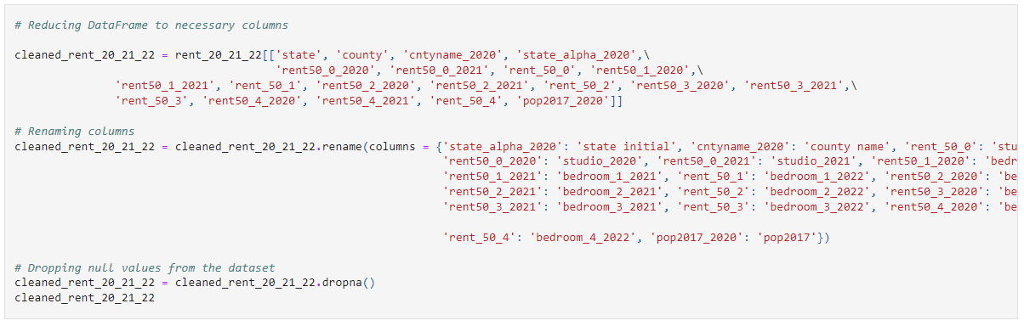
Cool Code: Cleaning data
2020-2022 median rent estimates for all of the different counties in the US. Rent estimates are for studios, 1 bedroom, 2 bedrooms, 3 bedrooms and 4 bedrooms.
Notes:
Gautam
Added a quick statement in the bottom that shows the data that we will be analyzing.

Slide 5
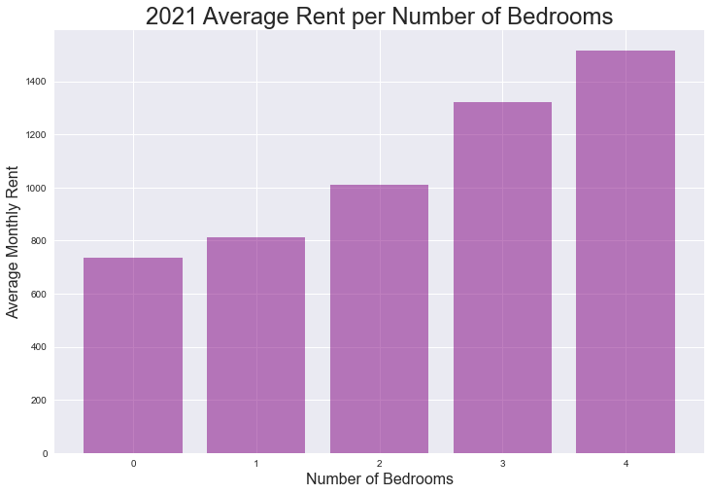
If Paul wants to live alone, should he go for a studio or a 1 bedroom?
% Increase from studio to 1 bedroom: 10%
% Increase from 1 bedroom to 2 bedrooms: 22%
% Increase from 2 bedrooms to 3 bedrooms: 26%
% Increase from 3 bedrooms to 4 bedrooms: 13%
Insert graph here
If space is important for Paul, we recommend a 1 bedroom, as there is only a 10% increase from a studio to a 1 bedroom apartment.
Notes:
Vinika
The average monthly price of a 4-bedroom place is $782 higher than a studio apartment. As the number of bedrooms increases, the average monthly price increases as well.
% Increase from studio to 1 bedroom: 10%
% Increase from 1 bedroom to 2 bedrooms: 22%
% Increase from 2 bedrooms to 3 bedrooms: 26%
% Increase from 3 bedrooms to 4 bedrooms: 13%
Vinika

Slide 6
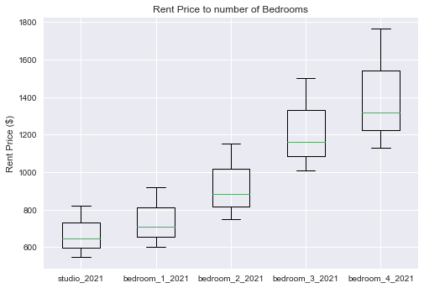
Rent Price vs Number of Bedrooms
Notes:
Vinika
bedroom types (boxplot)

Slide 7
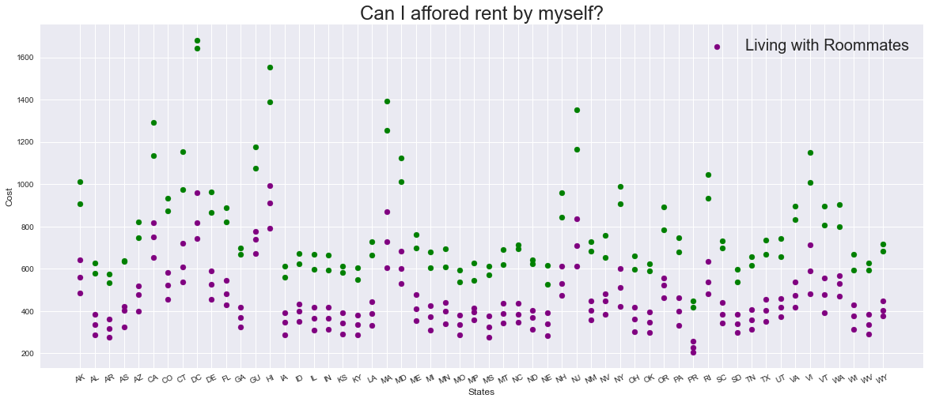
Considering a roommate?
Notes:
William - Two things this tells me, If our budget here is $600 - $1,100 a month across state averages I should be able to find a place alone, however roommates would definitely save me money. If my budget is $600 below I may really want to consider some roommates.
In this set of data for each additional bedroom the avg total cost is divided by one.

Slide 8
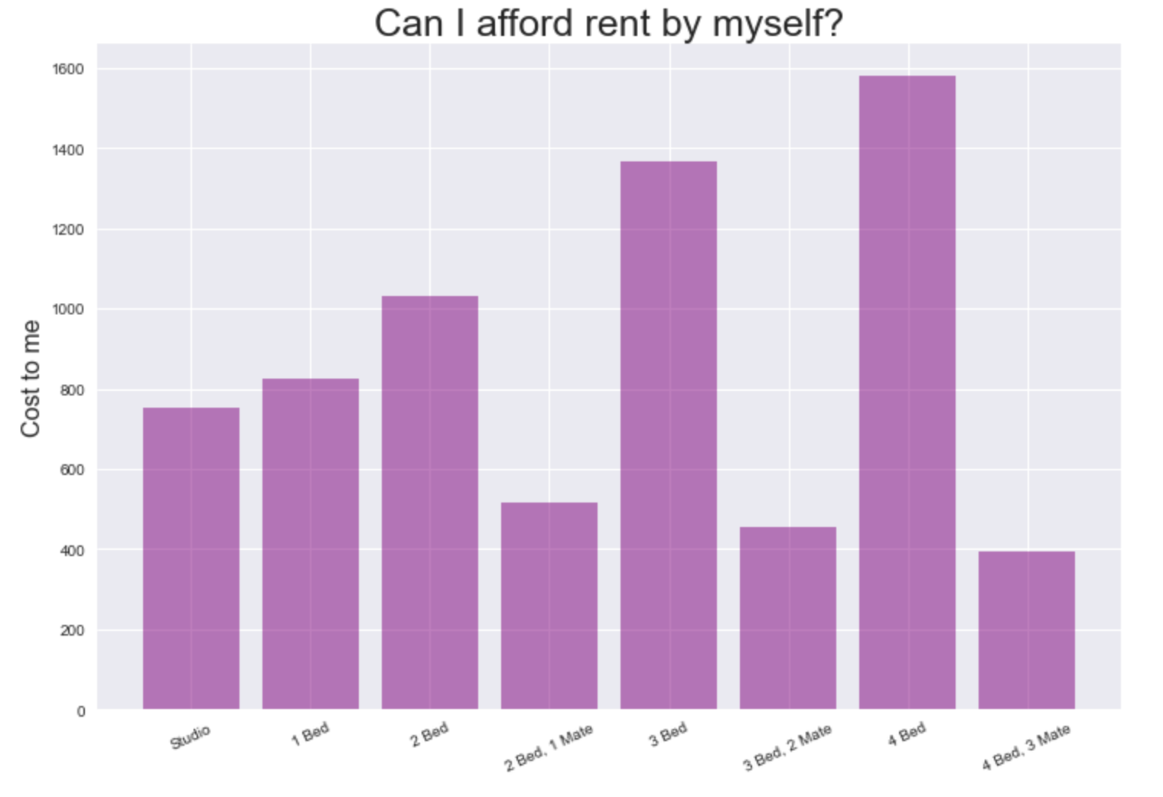
Considering a roommate?
With Paul's budget and preference in mind he thinks a one bedroom with no roommates will be ideal for him.
Notes:
William
Budget 1,100

Slide 9
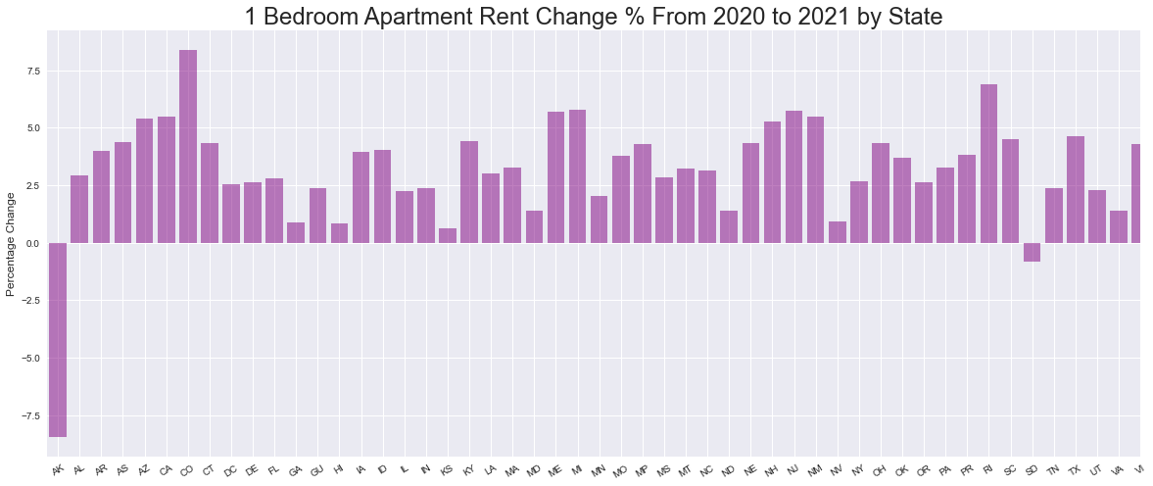
Looking At Percentage Changes in Rent…
Notes:
Sarje: Arkansas dropped in price dramatically and South Dakota dropped in price a little bit, whereas Colorado, Rhode Island, Arizona, California, Maine, Michigan, New Hampshire, New Jersey, and New Mexico all increased quite a bit.

Slide 10
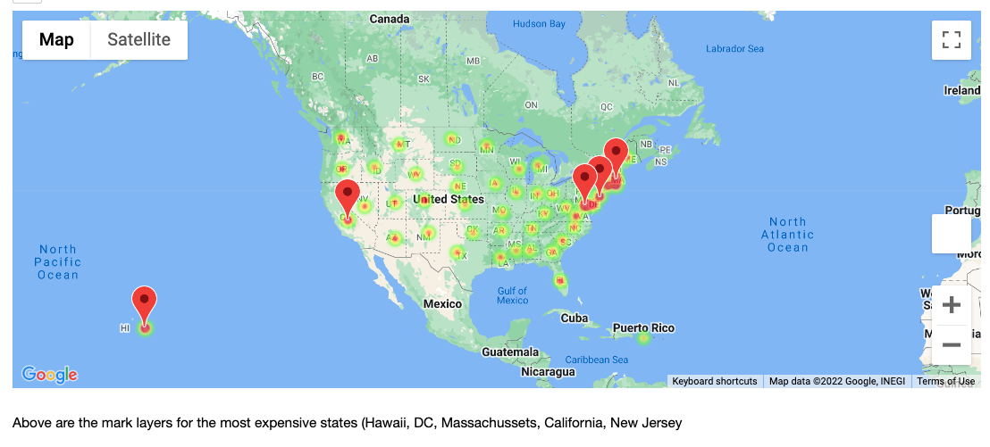
What are top 5 states with the highest rent for a 1 bedroom?
Hawaii
DC
Massachusetts
California
New Jersey
Notes:
Sheyla

Slide 11
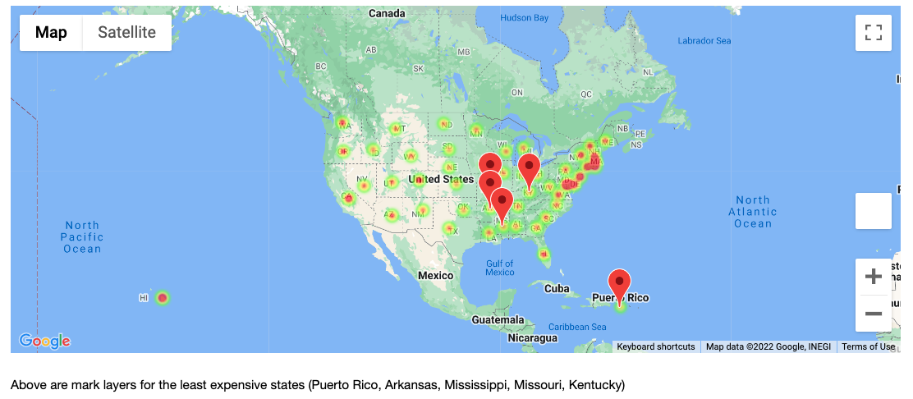
What are top 5 states with the lowest rent for a 1 bedroom?
Puerto Rico
Arkansas
Mississippi
Missouri
Kentucky
Notes:
Sheyla

Slide 12

Georgia on My Mind…
Notes:
Sheyla

Slide 13
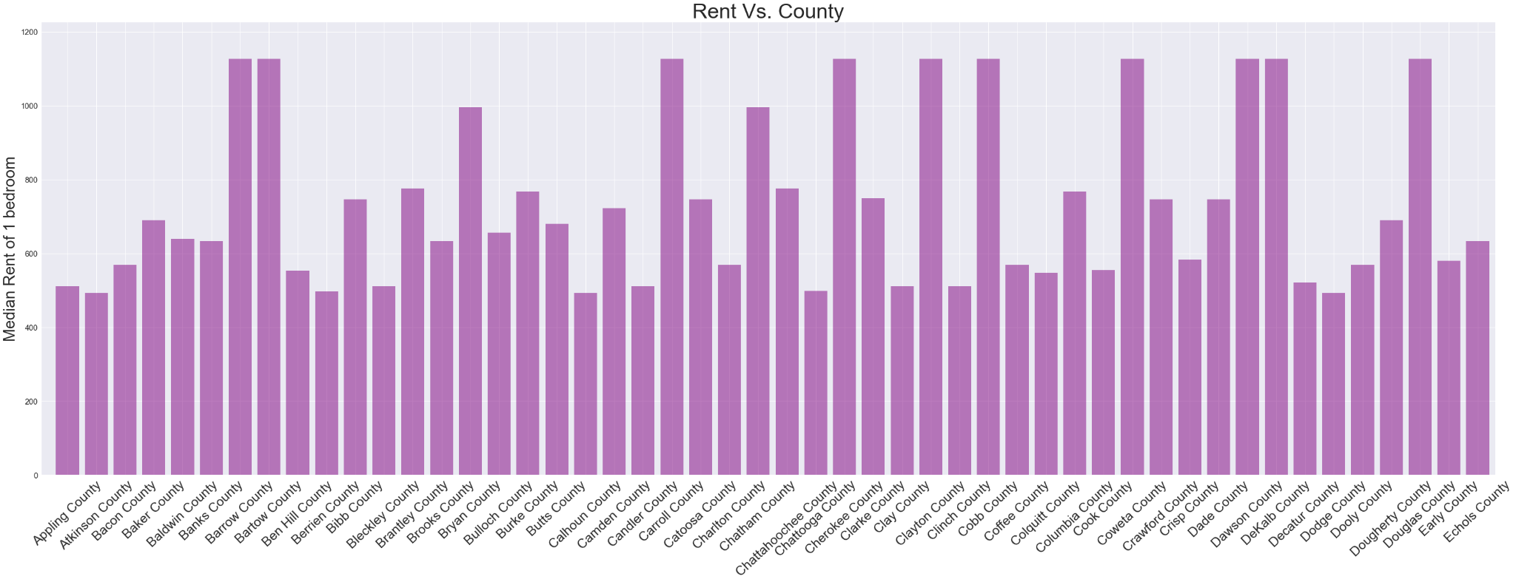
Rent Price varies by GA County
Insert map/graph here today
Notes:
Sheyla
Ga avg one bedroom county (bar)

Slide 14
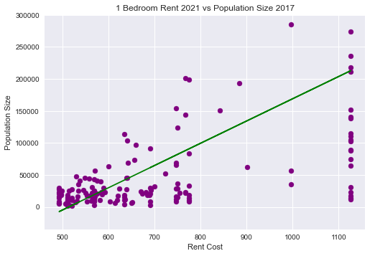
County Population vs Rent Cost of a 1 Bedroom Apartment
R value: 0.5256
Notes:
Ga pop (scatter plot)
Andres Almaraz

Slide 15
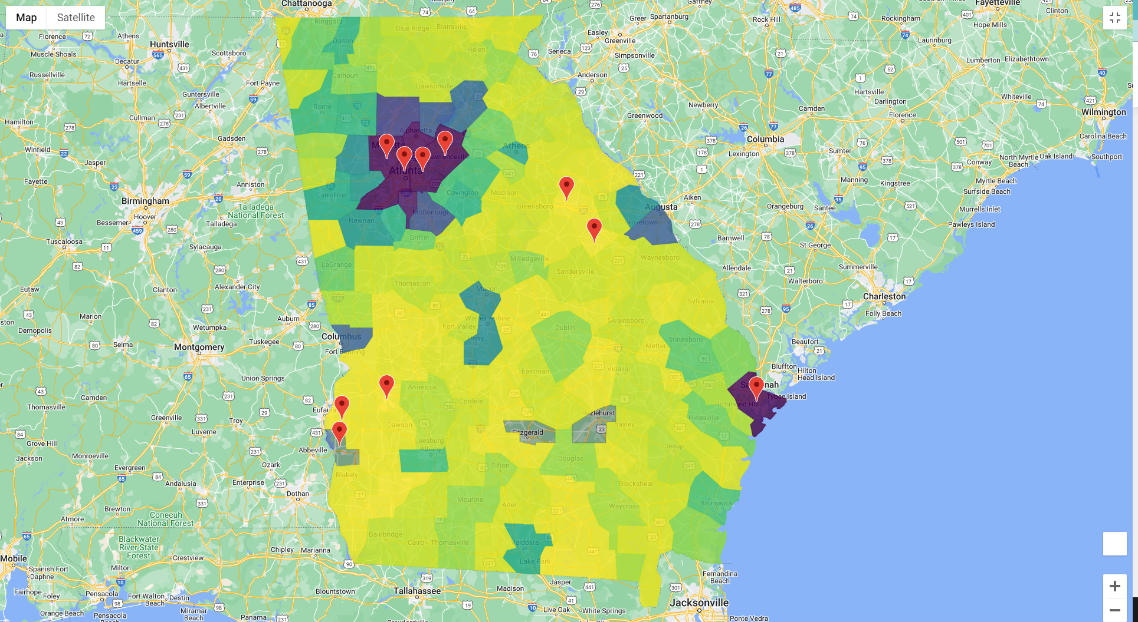
Ga Population by County Heat Map
Notes:
Ga pop by county (heat map)
Andres Almaraz

Slide 16
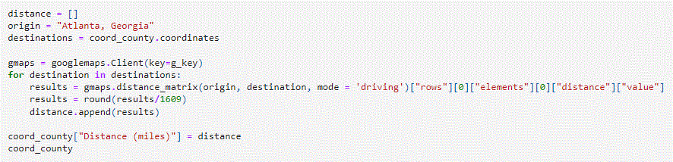
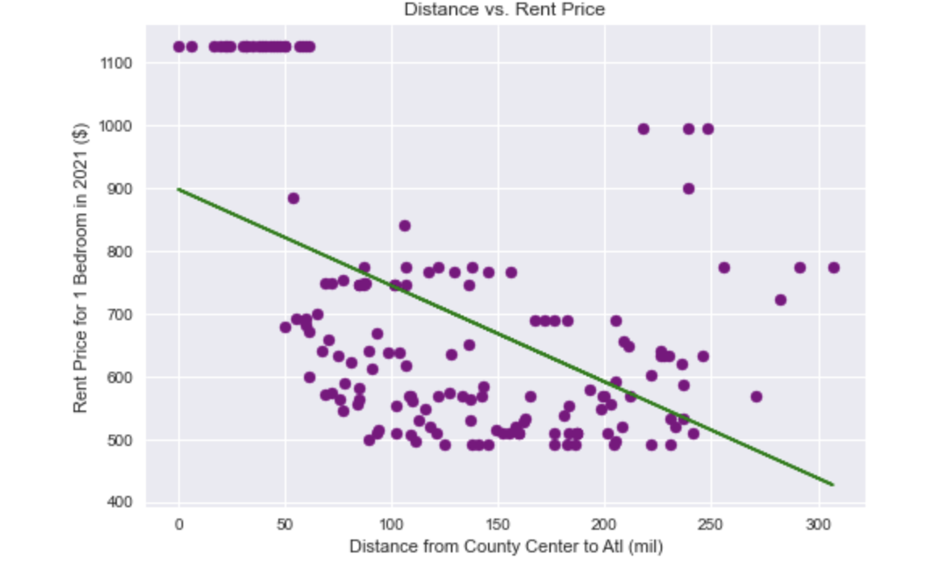
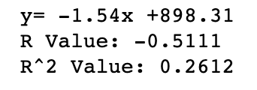
How does location affect rent prices?
Notes:
Ashley:
Demonstrates the relationship between distance and rent price. Rent price is higher within 60 miles of the city center (Atlanta); however, the rent price increases as you move out again. This correlates to the population heatmap seen in the previous slide. As you move closer to the coast (Savannah), the rent increases indicating that while distance does have an impact on price, population goes hand in hand.
Ashley: Using the Google Maps function, you can calculate the distance between two locations by different modes (driving, walking, etc.). Divided the results by 1609 to convert m to miles.

Slide 17
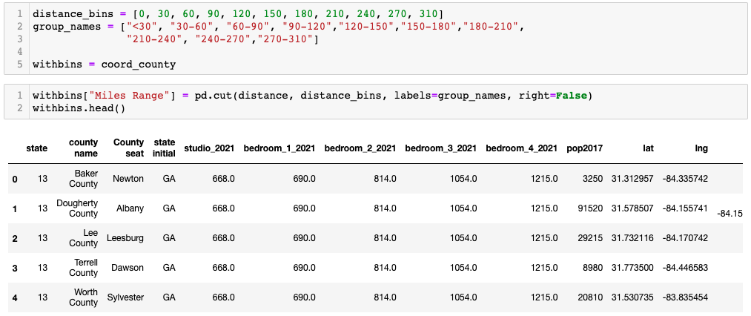
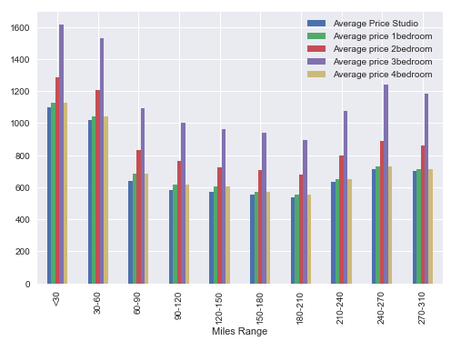
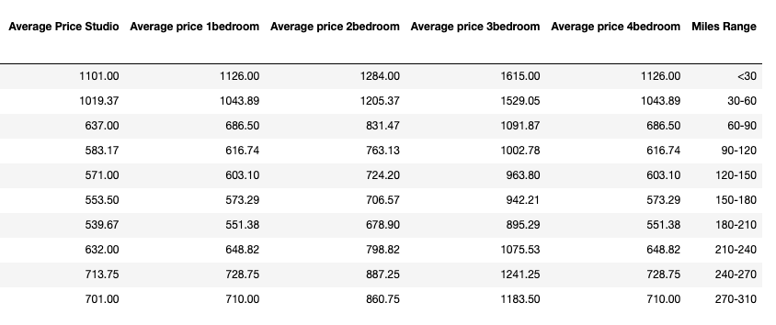
Price changing based on the distance range
Notes:
Huda: Average rent vs distance (boxplot & bar plot)

Slide 18
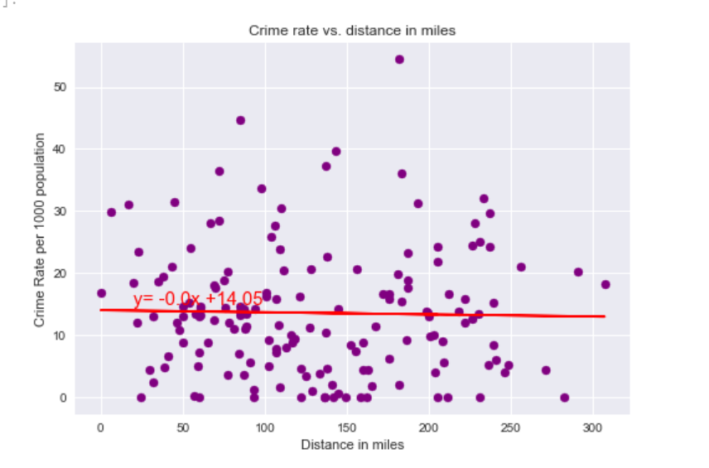
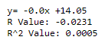
What About Safety? How safe are the
Counties of Georgia?
Correlation between Crime rate and distance from the center of ATL
Based on the plot, it seems like there's a weak negative correlation between the crime rate and the distance from Atlanta. Overall, the crime rates are low in Georgia.
Since the distance does not matter, we would have to look at the crime rates in the counties where Paul is interested to move.
Notes:
Maheen:
Checking the Crime Rates in Georgia and trying to find a correlation between crime rates and the distance from ATL.

Slide 19
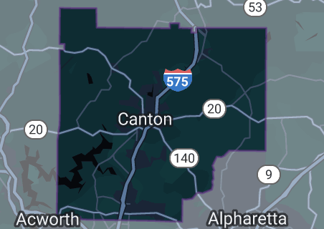
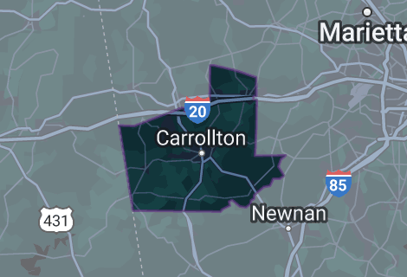
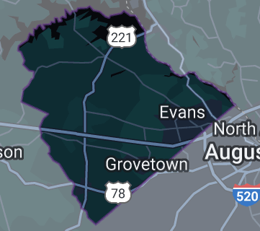
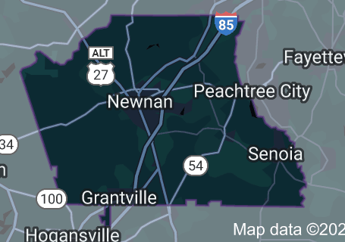
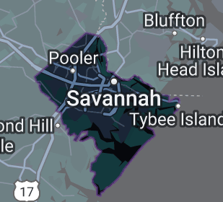
On My Mind
Coweta County
Chatham County
Cherokee County
Carroll County
Columbia County
Notes:
Maheen :
The counties that we’ve come up with and that fit with Paul’s interests.

Slide 20
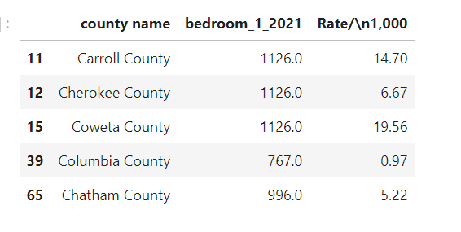
Crime Rates and 1 Bedroom Rent
Notes:
Maheen :
Crime rates in the counties selected together with the rent of a 1 bedroom apartment for Paul.

Slide 21
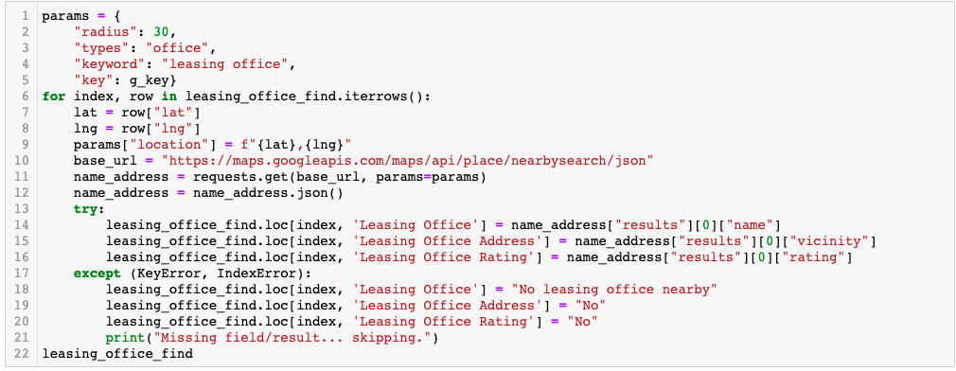
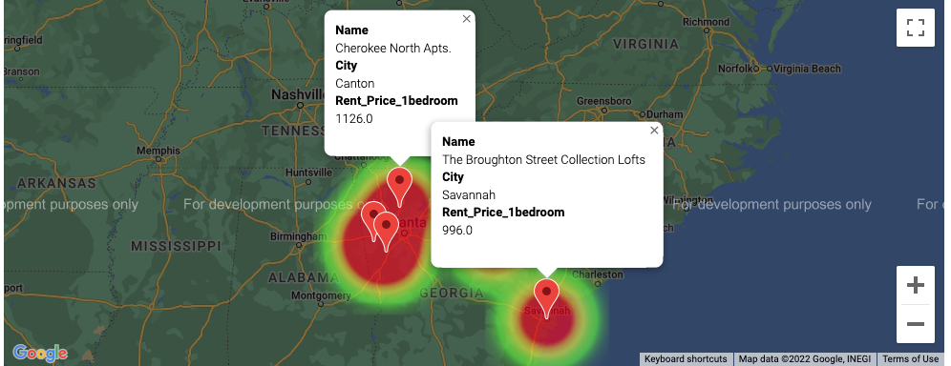
Leasing Office
Notes:
Maheen
Trying to find the leasing office in the counties selected

Slide 22
Conclusion:
From the Data collected, cleaned, merged and calculated based on States, counties, distance, crime rates and rents, we conclude that the best place for Paul to live in and move to is Columbia County. The rent for 1 bedroom apartment is affordable as compared to the other counties and it is the safest place to live in as compared to the other counties that Paul selected.
Columbia county has a lot of things to do outdoors like rock climbing, kayaking, water sports, golf, horseback riding and many parks for hiking. It is close to Augusta too which would be a nice weekend trip for Paul to enjoy.
Notes:
Gautam
Columbia County

Slide 23
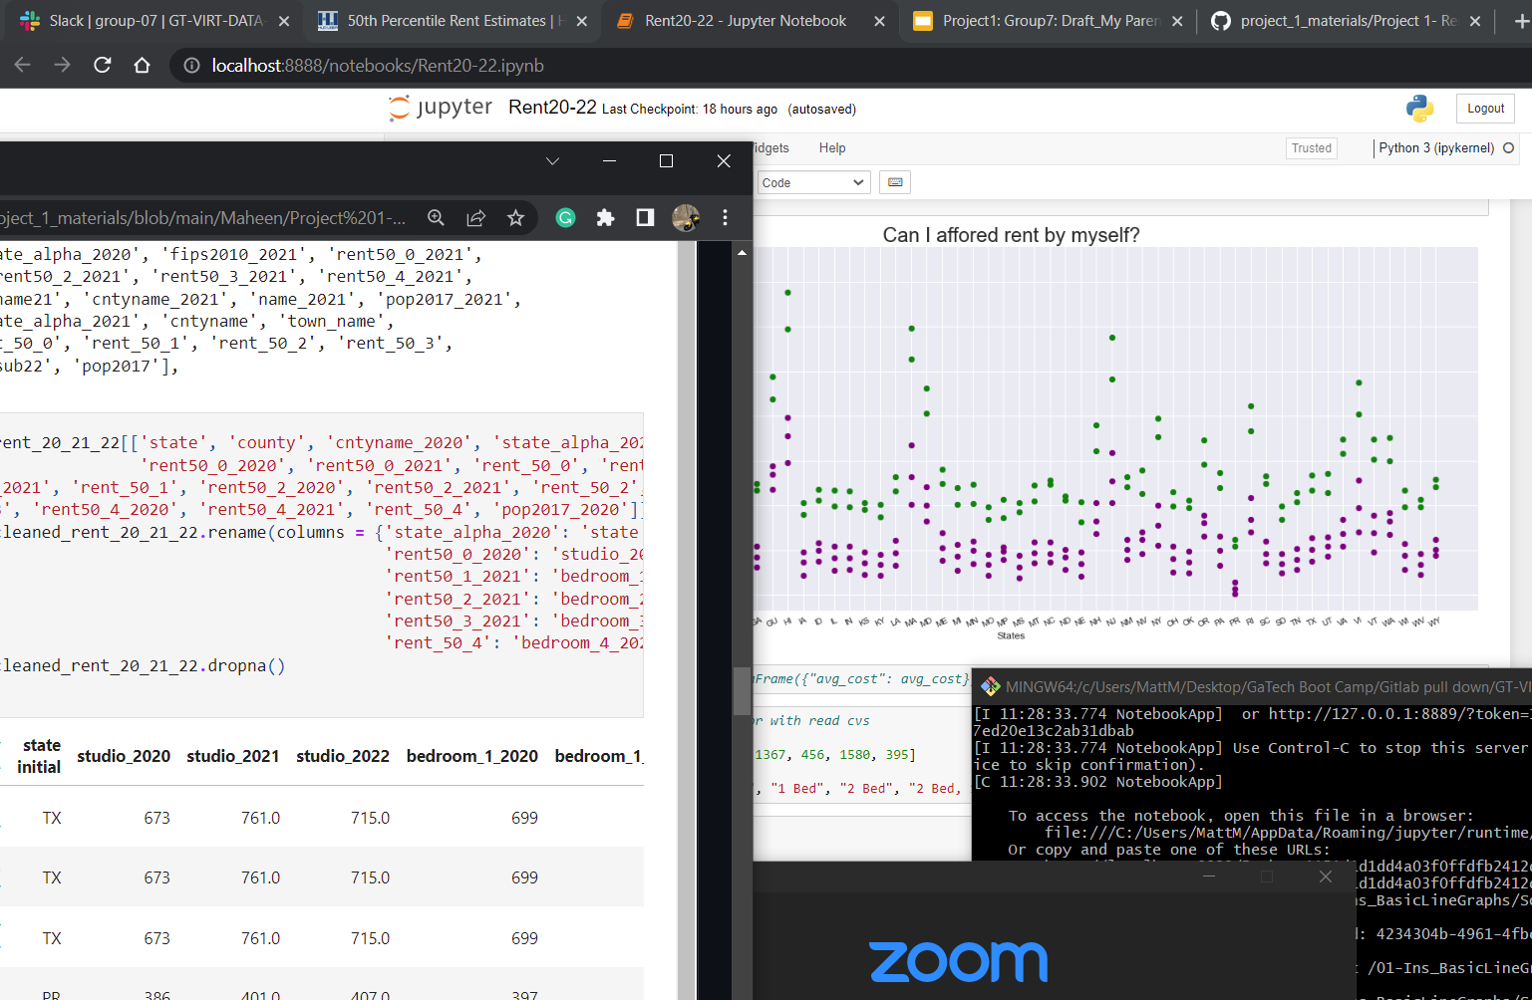
Team Setup and Coordination
We had a process of everyone contributing ideas one at a time to developed an exhausted list we had interesting in.
We then discussed scope of work that would give a subject better standing. (i.e. access to relative data, API opportunity and clean data would be ideal)
After agreeing on renters data over a span of years provided by Hud User. We again developed a list of questions relevant. Teamed up in some sub groups and got to exploring.
As a team we met up on Sundays for additional work, brainstorming and coordination.
Notes:
“IN closing” … Gautam
How did we come up with this set of data?
Show process of everyone's input in on the subject
William- Maybe Sarje, can recap few sentences be our intro and describe shortly the process of how we arrived at title and and data subject?
//maybe another slide maybe here - I want people to be able to showcase their work. Don’t want to spend too much time here. Intro, starting steps, then let's get in to it.
Data cleaning and coordinating
We made a gitHub together talked about the data set as a group, then did large cleaning to the set. Talked about what we agreed on to use for our discoveries. Recaps nightly and start of class. Utilized the Slank channel and GitHub. This is about showing our process we worked together .
—------------------- into to how we did the work—---------------
We had a process of everyone contributing ideas one at a time to developed an exhausted list had interesting in.
We then discussed scope of work and variables that would give a subject better standing. (i.e. access relative data, API opportunity with simi-clean data would be ideal)
After agreeing on renters data over a span of years provided by Hud User. We again developed a list of questions relevant. Teamed up in some sub groups and got to exploring.
As a team we meet on sundays took active roles in class time to help each other out.
We have a great presentation for you today.

Slide 24
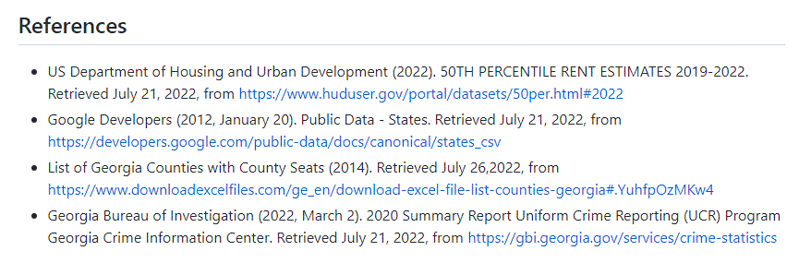
References:

